Slide 1
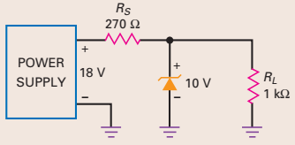

Initial tutorials on diodes
Determine the load current $I_{L}$, the series current $I_{S}$ and the Zener current $I_{Z}$.

Slide 2
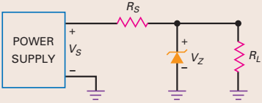
Initial tutorials on diodes
The zener diode has a breakdown voltage of 10 V and a zener resistance of 8.5 Ω. Use the second approximation to calculate the load voltage when the zener current is 20 mA.

Slide 3
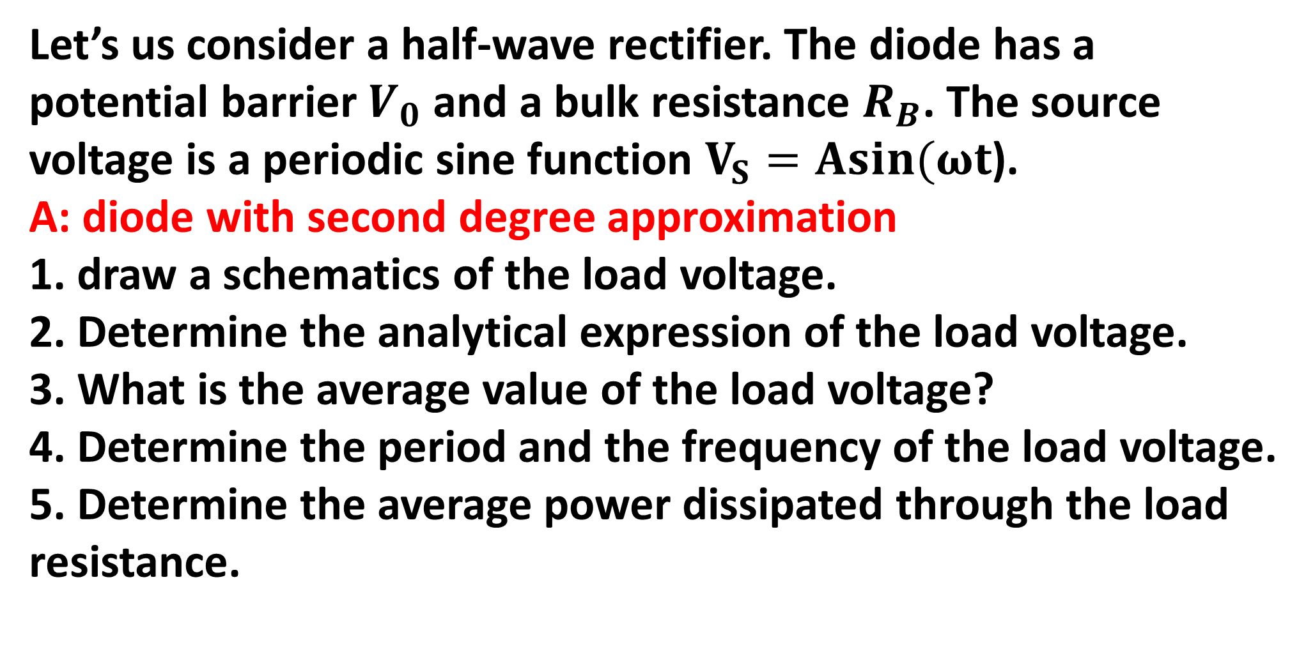
Initial tutorials on diodes
Let’s us consider a half-wave rectifier. The diode has a potential barrier $V_{0}$ and a bulk resistance $R_{B}$. The source voltage is a periodic sine function $V_{S}=Asin(ωt$).
A: diode with second degree approximation
1. draw a schematics of the load voltage.
2. Determine the analytical expression of the load voltage.
3. What is the average value of the load voltage?
4. Determine the period and the frequency of the load voltage.
5. Determine the average power dissipated through the load resistance.

Slide 4
Initial tutorials on diodes
B: diode with 3rd degree approximation
1. draw a schematics of the load voltage.
2. Determine the analytical expression of the load voltage.
3. What is the average value of the load voltage?
4. Determine the period and the frequency of the load voltage.
5. Determine the average power dissipated through the load resistance.

Slide 5
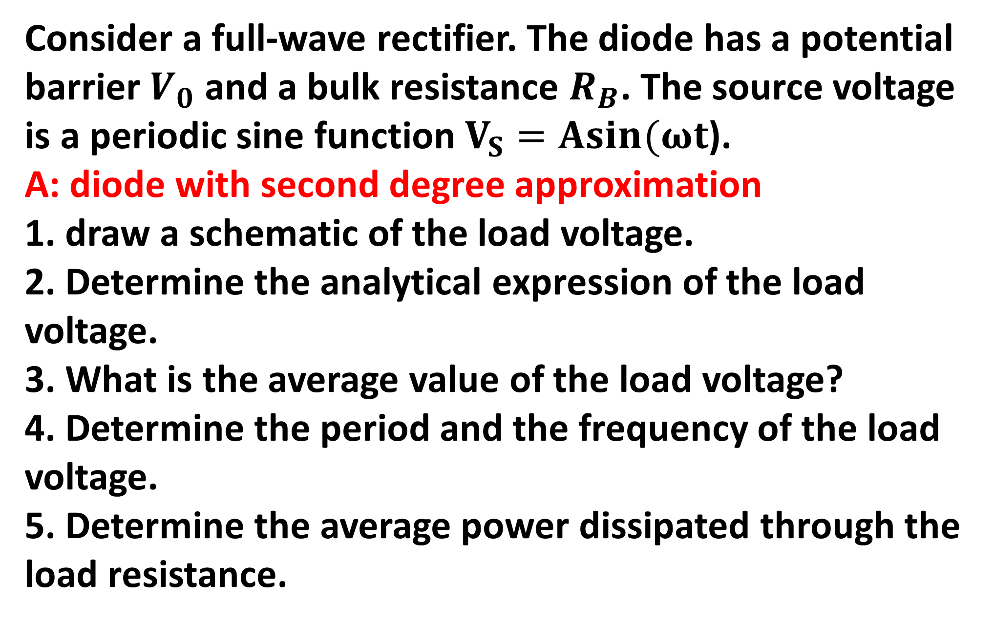
Initial tutorials on diodes
Consider a full-wave rectifier. The diode has a potential barrier $V_{0}$ and a bulk resistance $R_{B}$. The source voltage is a periodic sine function $V_{S}=Asin(ωt$).
A: diode with second degree approximation
1. draw a schematic of the load voltage.
2. Determine the analytical expression of the load voltage.
3. What is the average value of the load voltage?
4. Determine the period and the frequency of the load voltage.
5. Determine the average power dissipated through the load resistance.

Slide 6
Initial tutorials on diodes
Let’s us consider a half-wave rectifier where a capacitor is in parallel with the load resistance.
1. Draw and explain the voltage of the load resistance.
2. What is the RMS value of the load voltage?
3. Compute de ripple rate.

Slide 7
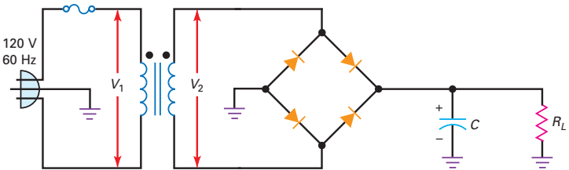
Initial tutorials on diodes
Let’s us consider a full-wave rectifier where a capacitor is in parallel with the load resistance.
1. Draw and explain the voltage of the load resistance.
2. What is the RMS value of the load voltage?
3. Compute de ripple rate.

Slide 8
Initial tutorials on diodes
Let’s us consider a full-wave rectifier where a capacitor is in parallel with the load resistance.
1. Draw and explain the voltage of the load resistance.
2. What is the RMS value of the load voltage?
3. Compute de ripple rate.

